Slide 1
Foundation of computer science
By : Mohamed Agami

Slide 2

Lecture 6
Motherboard part 3

Slide 3
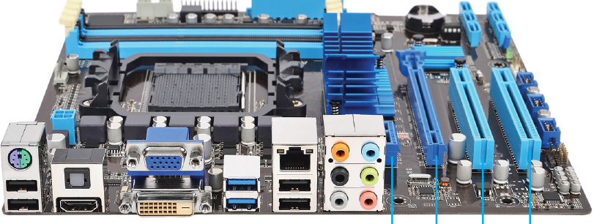
Expansion slots

Slide 4
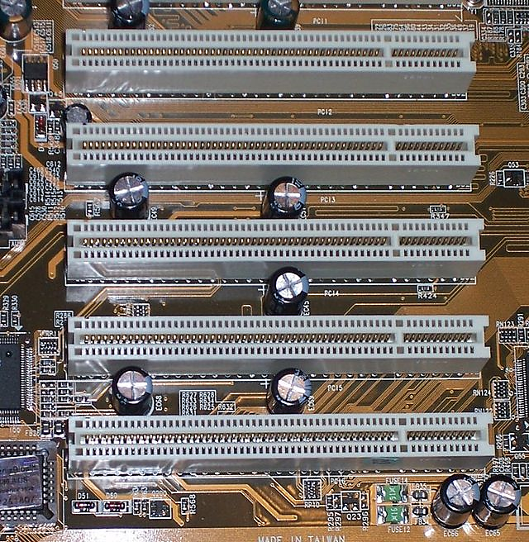
1. Conventional PCI
32-bit PCI
10101011001100101010110011001100
10101011001100101010110011001100
10101011001100101010110011001100
10101011001100101010110011001100
10101011001100101010110011001100
64-bit PCI
5V 33MH2
5V 33MH2
3.3V 66MH2
3.3V 66MH2

Slide 5
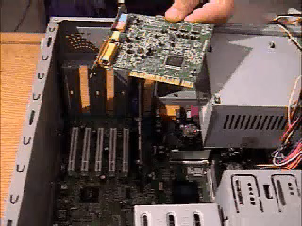

Slide 6
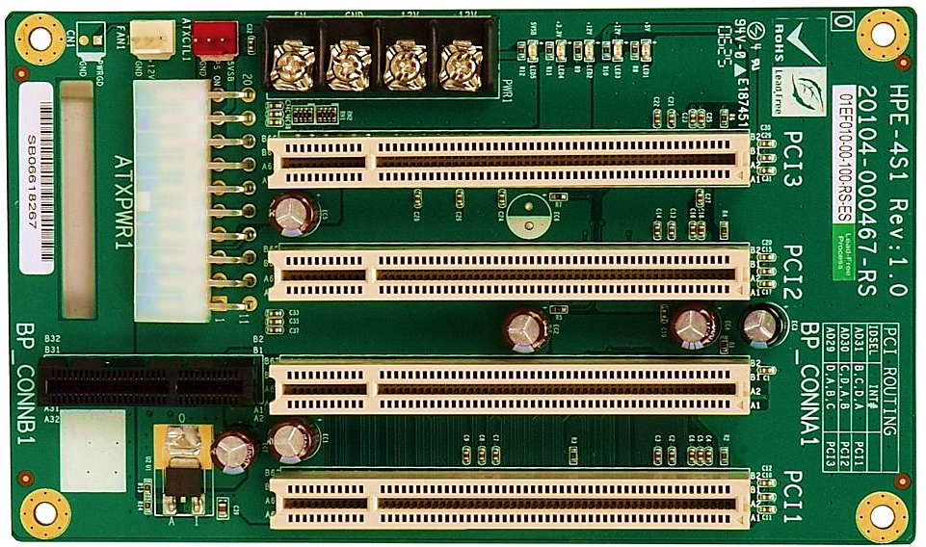
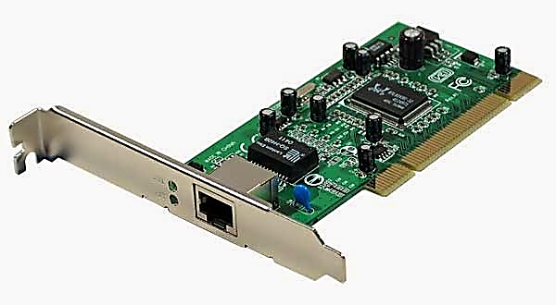
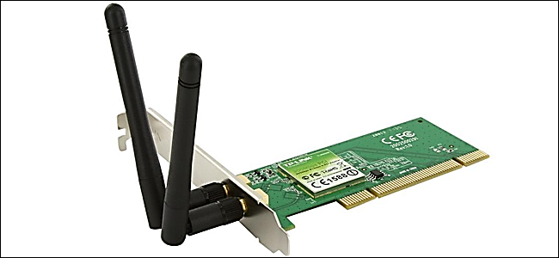
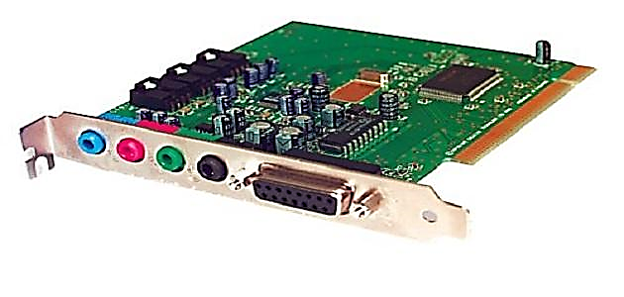

Slide 7
2. PCI Express (PCIe)
PCI uses a 32-bit parallel bus and use serial pus
PCI
PCIe
Parallel Bus
Serial Bus
011001100101
10101011001100101010110011001100
10101011001100101010110011001100
10101011001100101010110011001100
10101011001100101010110011001100
10101011001100101010110011001100
10101011001100101010110011001100
10101011001100101010110011001100
10101011001100101010110011001100
10101011001100101010110011001100
10101011001100101010110011001100
10101011001100101010110011001100
10101011001100101010110011001100

Slide 8
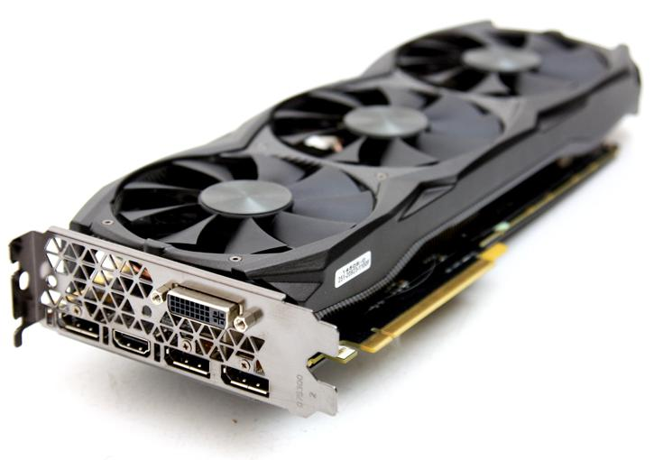
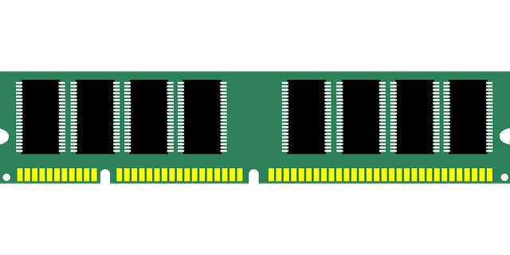

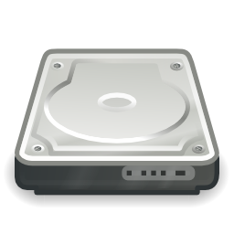
CPU
Front Side Bus(FSB)
64-bit Bus
North Bridge
Graphics/ Memory Controllers
Drives
PCIe Slot
PCIe Link
South Bridge
I/O Controller Hub(ICH)
PCIe Slot
PCIe Link
PCI Link
USB
Sound
PCI Slots

Slide 9
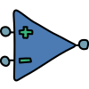
2. PCI Express (PCIe)
PCI
PCIe
It does not support sending and receiving data at the same time
Sending and receiving data at the same time
receive
Send

Slide 10
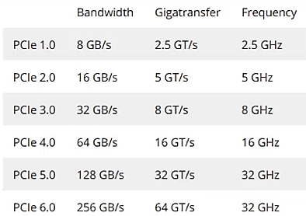
PCI Express

Slide 11
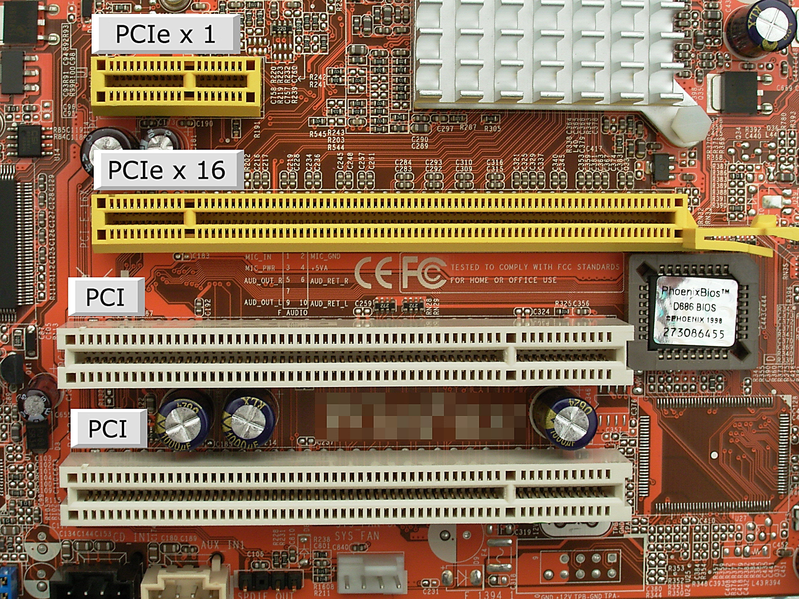
PCI Express

Slide 12
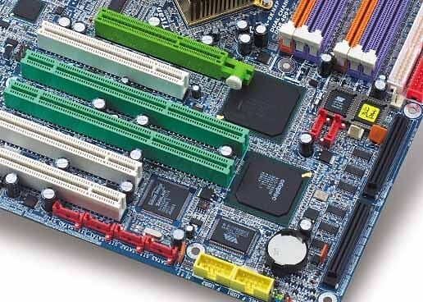
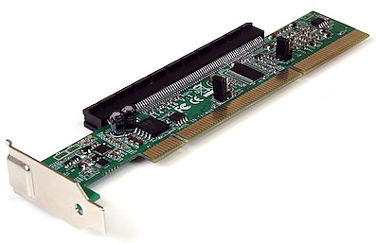

Slide 13
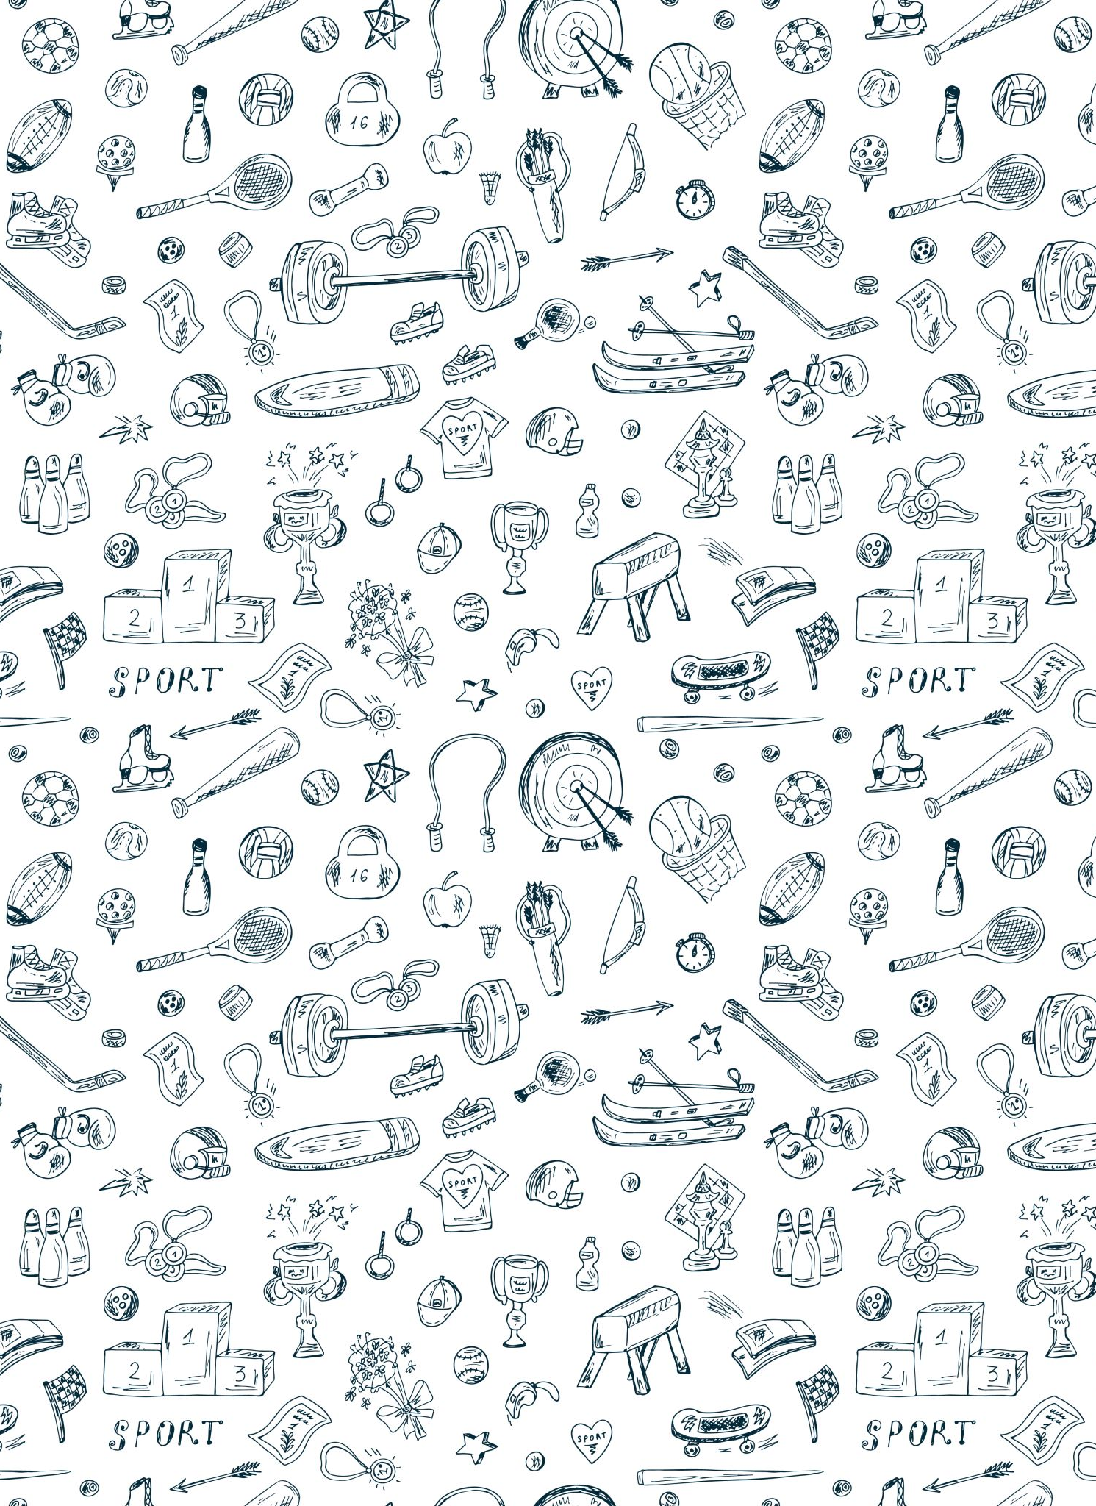
Tank you

